Slide 1
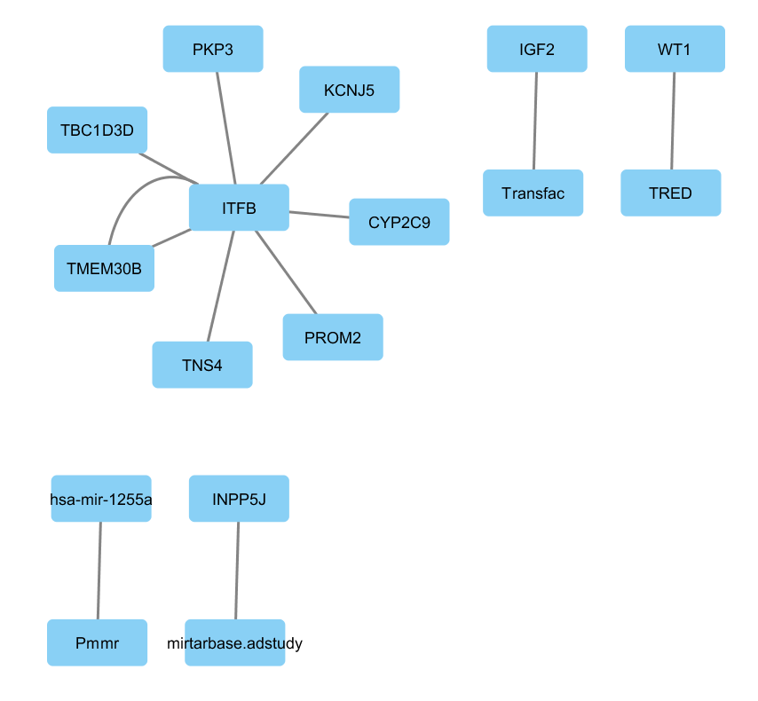
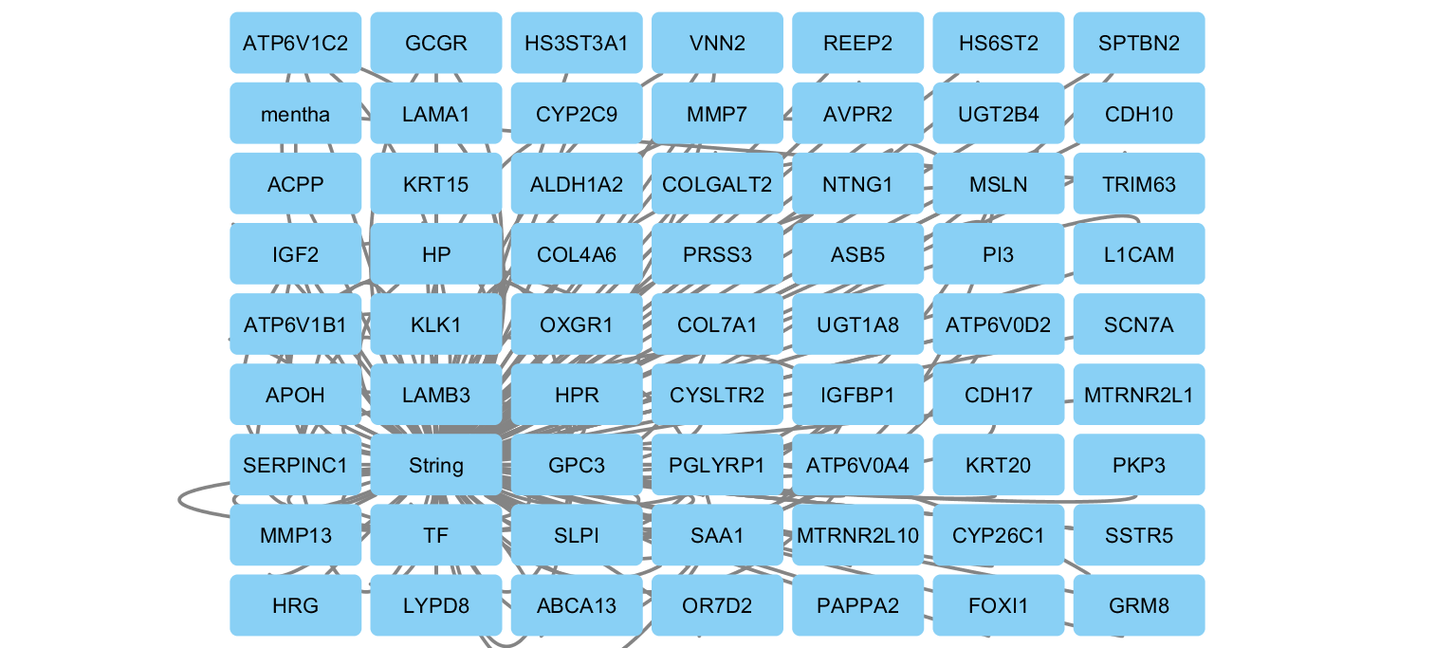


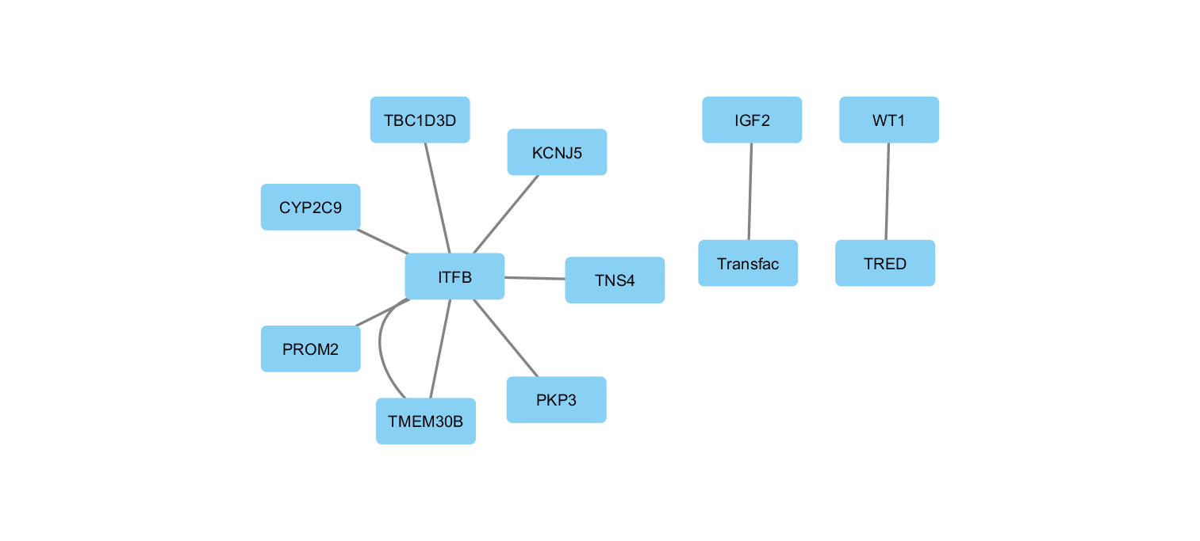

Complete
Gene-Gene
miRNA-Gene
miRNA-miRNA
TF-Gene
Disease

